Slide 1
Indoor Localization Using Computer Images
Yarkın Alpmen Akyosun & Kağan Kağanoğlu

Slide 2
Overview
Dataset
Design A
Depth Estimation Tests
Design B
Object Detection Tests
Future Work & Next Steps

Slide 3
Dataset Analysis
7-Scenes dataset contains data captured by scanning a rgb-d camera in a sequential paths in multiple different (independent) locations.
Each location features different objects.
Data recorded is presented as a sequence of following tuple of files for every position: colored image, grayscale depth image and position information as text.
Due to certain characteristics of data collection process and device characteristics some forms of error exist.

Slide 4
Device Characteristics
Data is collected with a Kinetic Depth camera which uses IR illumination to calculate distance.
Depth maps in our dataset contains a potentially unwanted property, where some regions between two relatively further away points are measured to be very close to camera, despite we can observe that those points actually should be similarly further away from camera. We hypothesis this to be due to difference of reflection of IR radiation from different surfaces

Slide 5
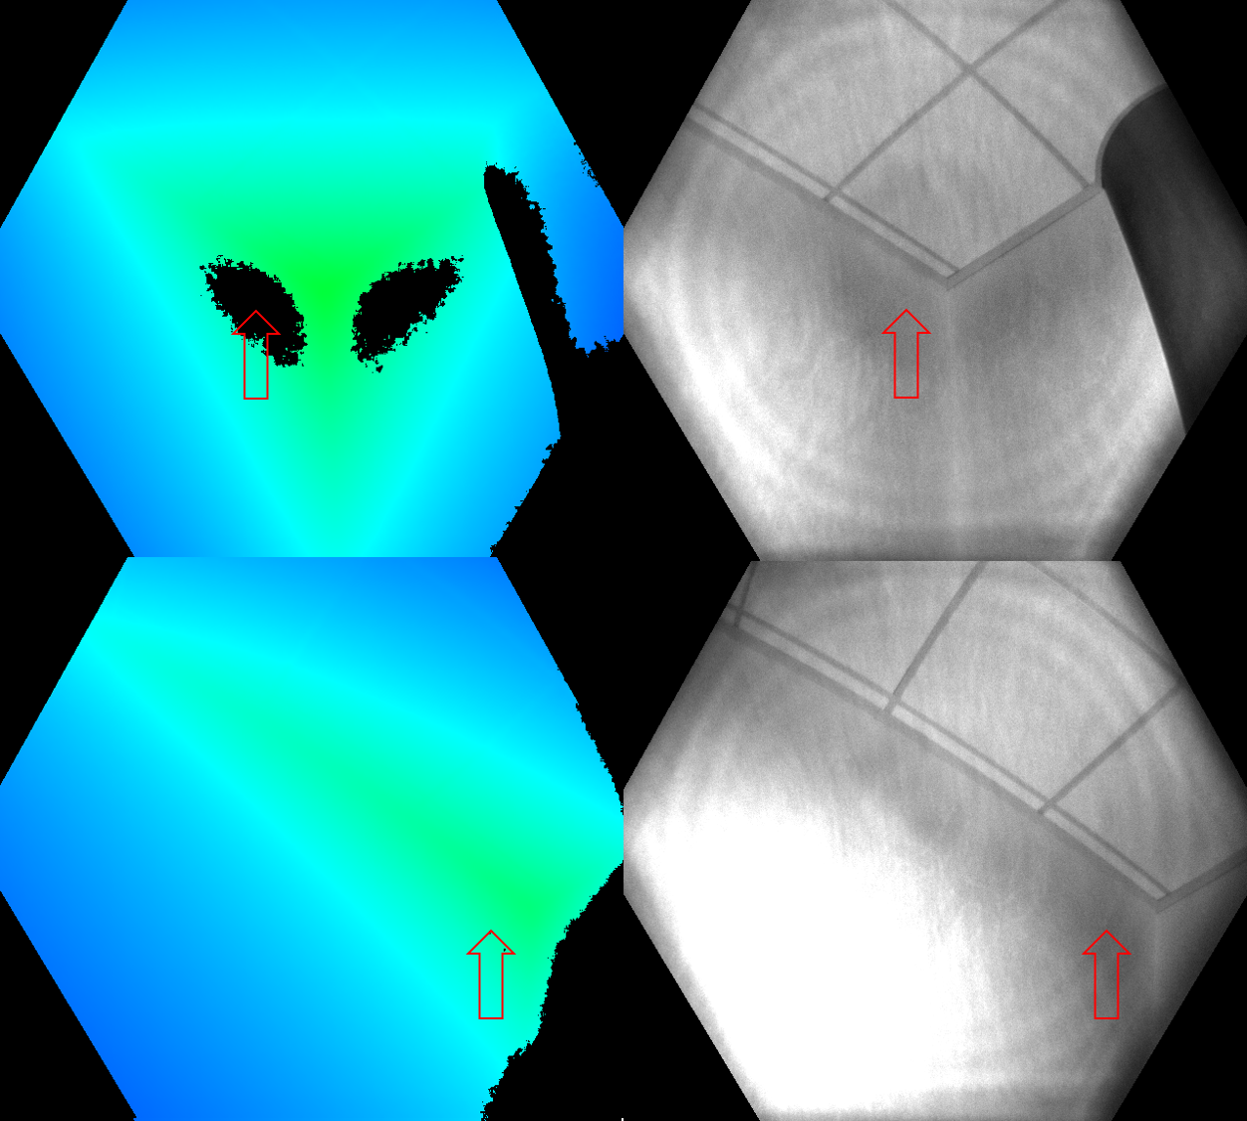
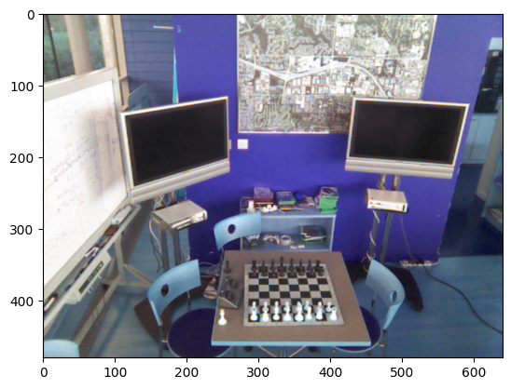
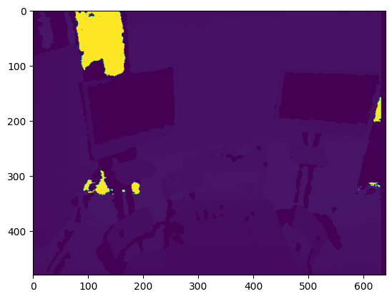
Device Characteristics
Another error in dataset is due to sensor reading errors which result in patches of incorrect distance measurements.

Slide 6
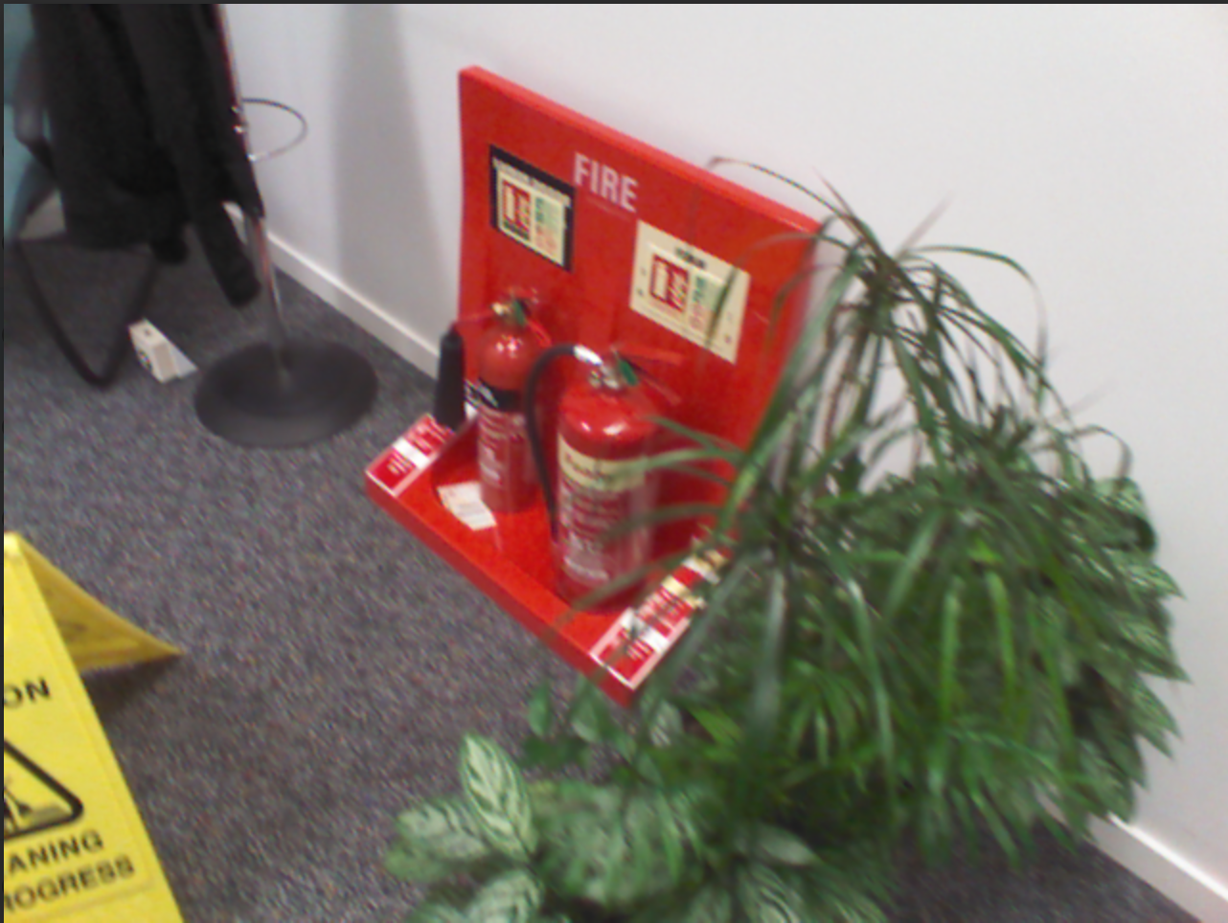
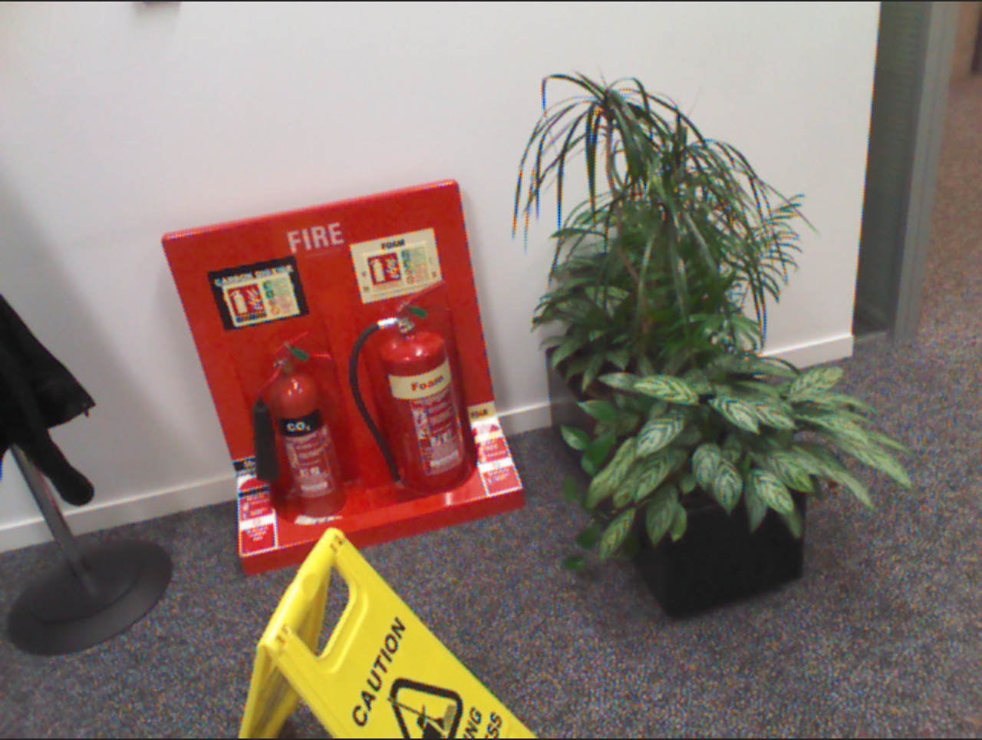

Slide 7
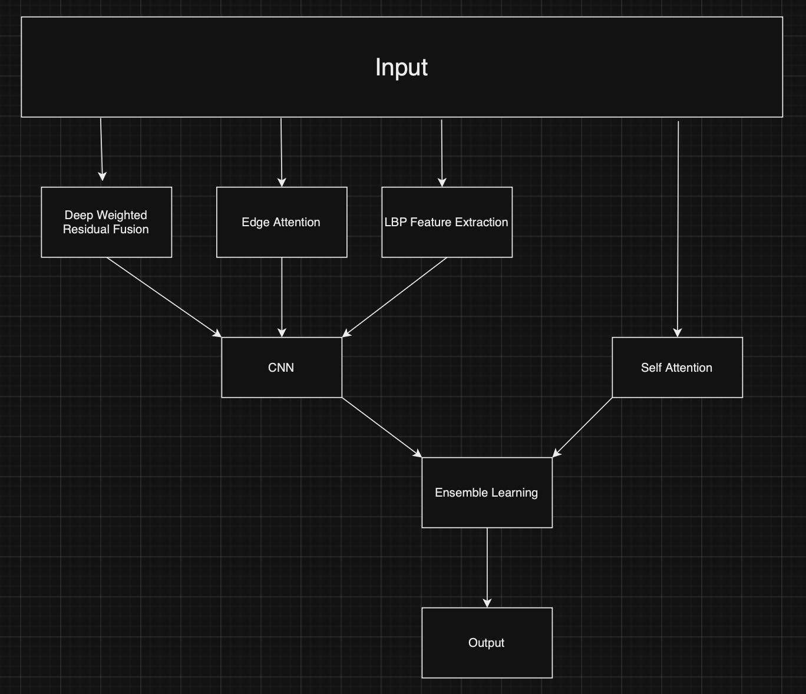
Design A
Enhance indoor localization accuracy by integrating several feature extraction processes.
Feature Extraction Techniques
Neural Network Architecture
Ensemble Learning

Slide 8
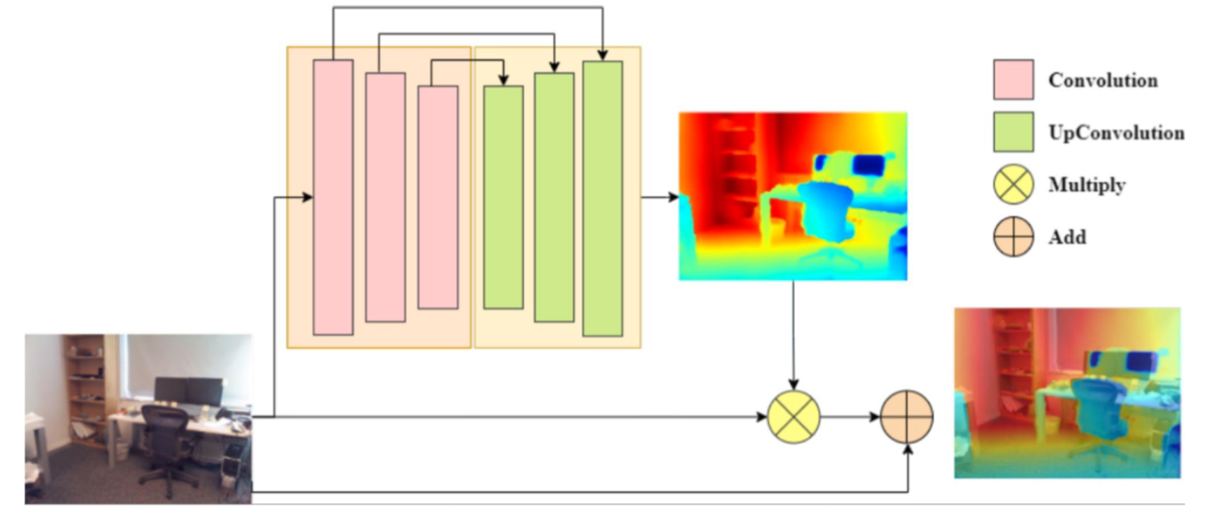
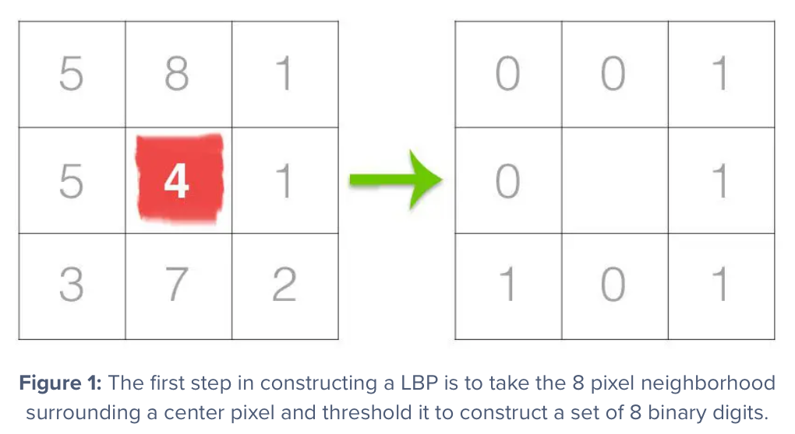
Feature Extraction Techniques
Depth Weighted Residual Fusion
Local Binary Patterns (LBP)
Edge Attention

Slide 9
Neural Network Architecture
Convolutional Neural Network (CNN)
Ability to capture spatial features & patterns
Recognize high level abstract features as well as shallow low level features
Used in many indoor localization tasks

Slide 10
Self Attention & Ensemble Learning
Self Attention
Capture long range dependency
Robust to noise and distractions
Ensemble Model
Shallow neural network as ensemble model
Efficient and prone to overfitting

Slide 11
Depth Estimation Tests
One of the features our architecture relies on is depth estimation generated from rgb images.
Before proceeding with further development stages we wanted to test strengths and weaknesses of depth estimation in order to ensure that reliable depth estimation is possible.
We utilised MiDas pre-trained model for our relative depth estimation tests.

Slide 12
Depth Estimation Fundamentals
Depth estimation models use rgb images to predict a greyscale image where brightness of pixels are proportional to depth of projected position.
Since predictions are relativistic, an ideal predictor would return images where each pixel value is directly proportional to its distance where for every image a consistent linear relationship shell exist with brightness values and real distance.
In our preliminary analysis of MiDas predictions, we tested predictions from rgb images with ones in grand truth to determine alignment to linear scale and error rates.

Slide 13
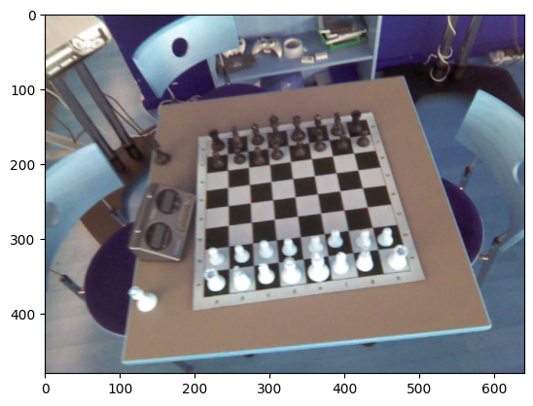
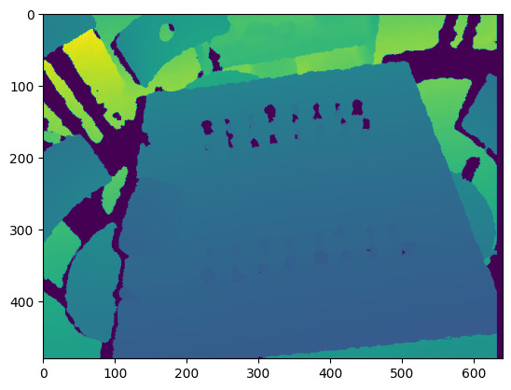
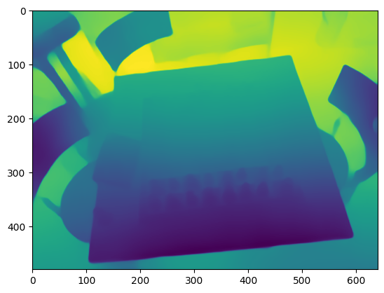
Depth Measurements vs Prediction
Below images show visualisation of an example prediction. In placement order, colored image, original depth image scaled and predicted image. An interesting observation which will also be seen on later examples is that ground truth image has very contrasted depths in some positions. We hypothesized that this is due to different reflectance of surfaces to IR.

Slide 14
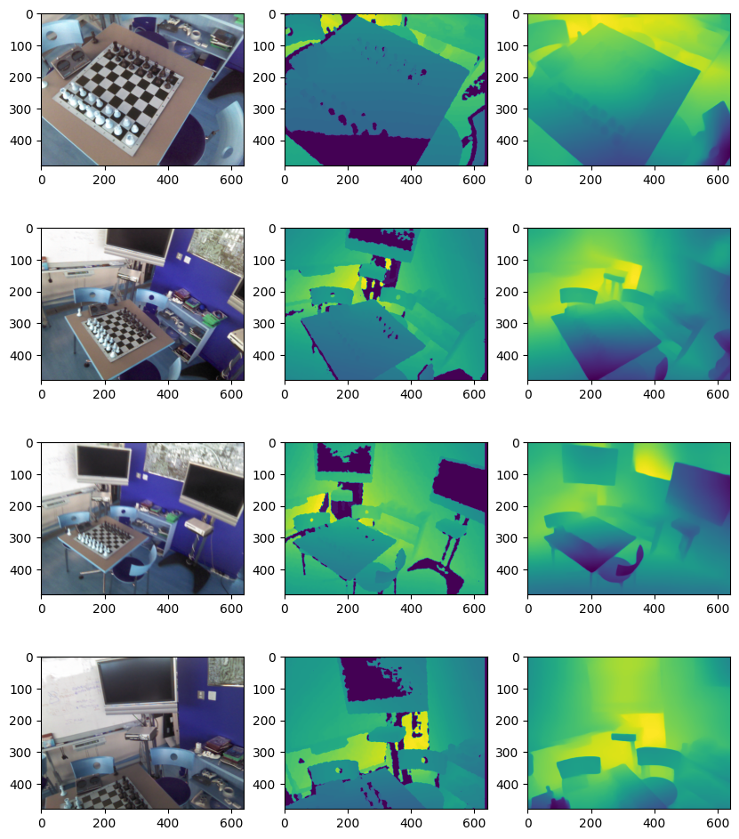

Slide 15
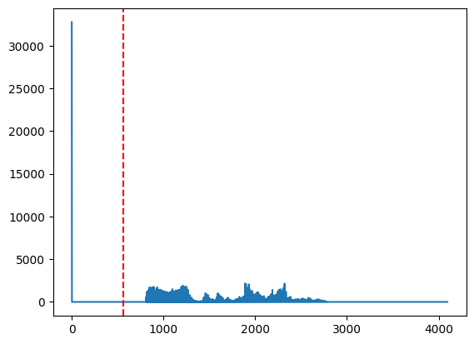
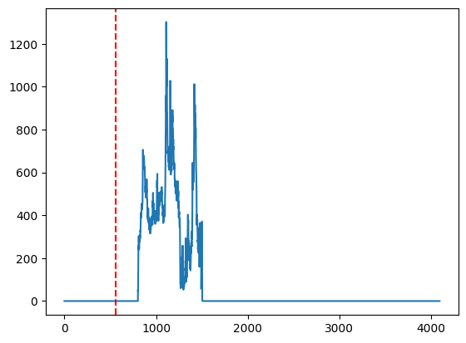
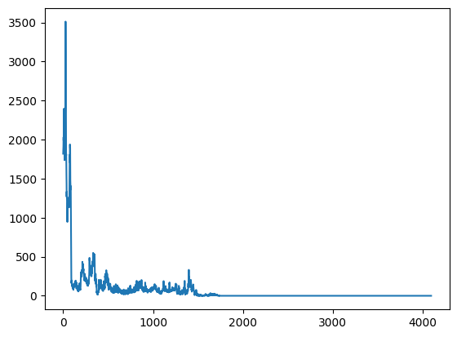
Depth Estimation Robustness
Below are histograms of images in previous slides (first 2 are depth maps and third one is absolute error). Red lines show RMSE for selected images prediction which is around 58cm. Most of the error is concentrated in lower distance values.

Slide 16
Design B
While design A focuses on capturing lower level features, our second design focuses on higher (object) level features for inferring position
Object detection
Depth estimation
Position & Orientation inference with collected object level features

Slide 17
Object Detection
Objects presented in the scene are detected by a foundational model.
Depth map, object category and relative position estimation of the objects projection in 2d colored photo (bounding box) will be transferred to a model we will train to predict position and orientation vectors.
Detection is categorical not instance level, this is a potential error point since coordinates of the wrong instance can be assumed. Countermeasures will be developed in further stages.

Slide 18
Object Detection Testing with YOLO
Zero-shot Learning with YOLO
Performs object detection
Aims to create object boundaries for design B

Slide 19
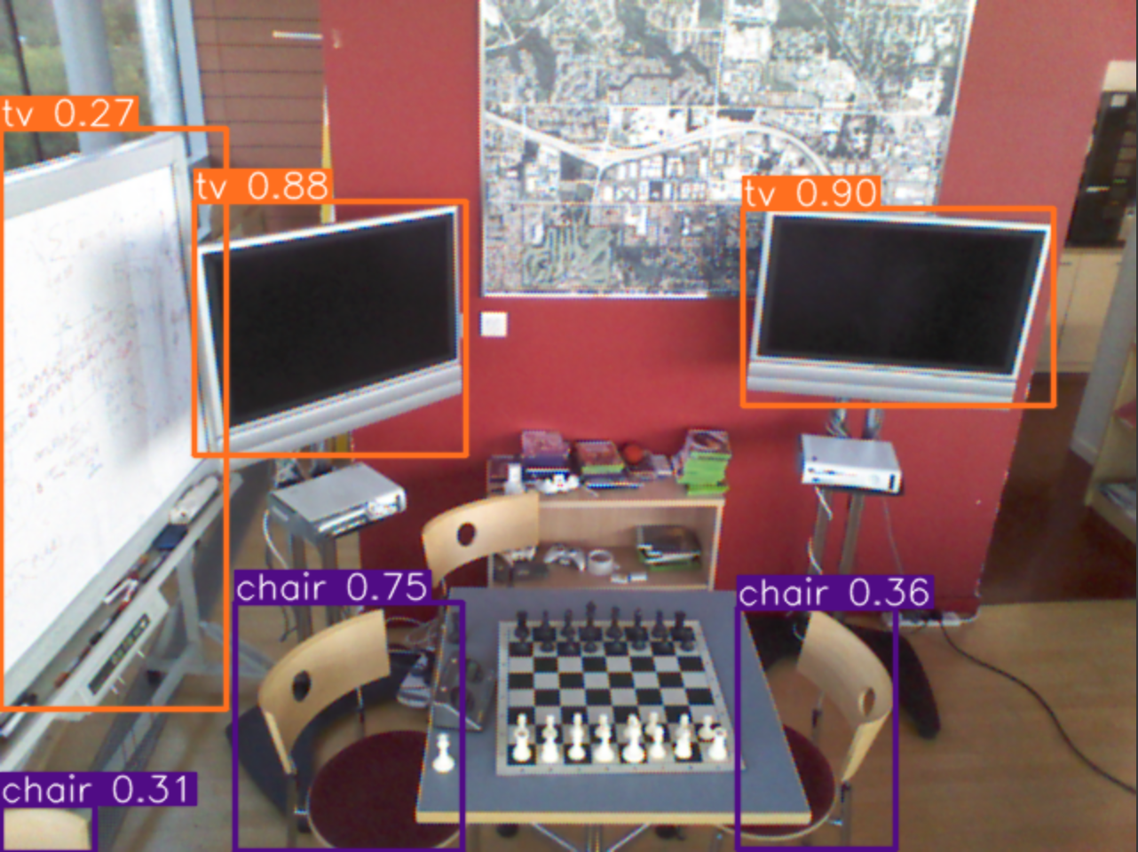
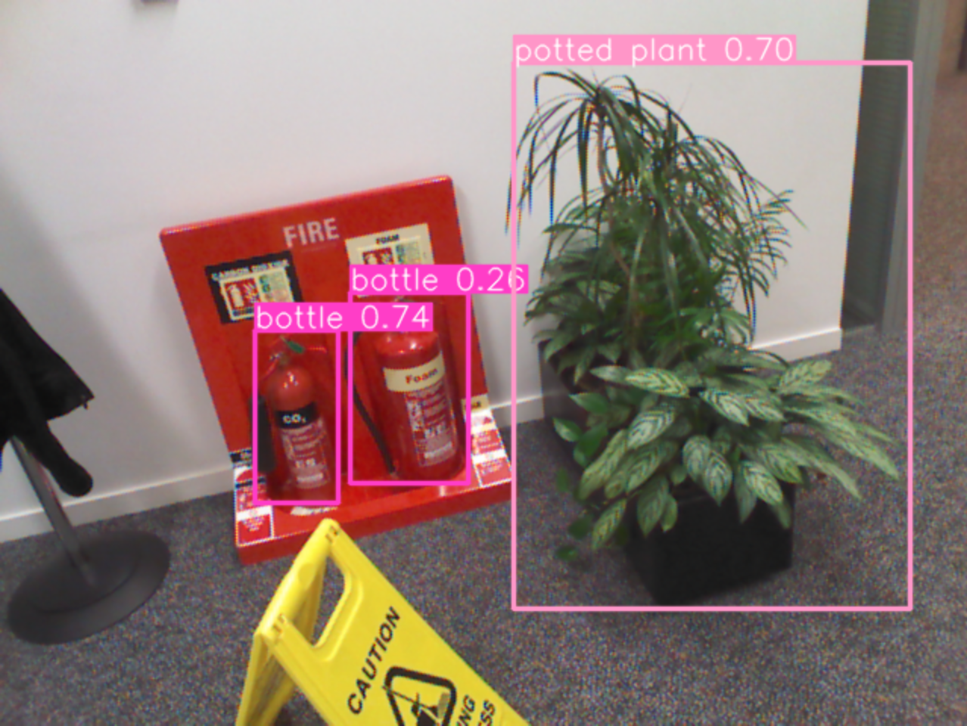
YOLO Tests

Slide 20
Future Works & Next Steps
Work on possible object detection models, optionally pretrained with similar dataset and objects to ours.
Implement Design A and B, and test to get first results.
Start optimizing the designs, and compare the results with other papers.

